Slide 1
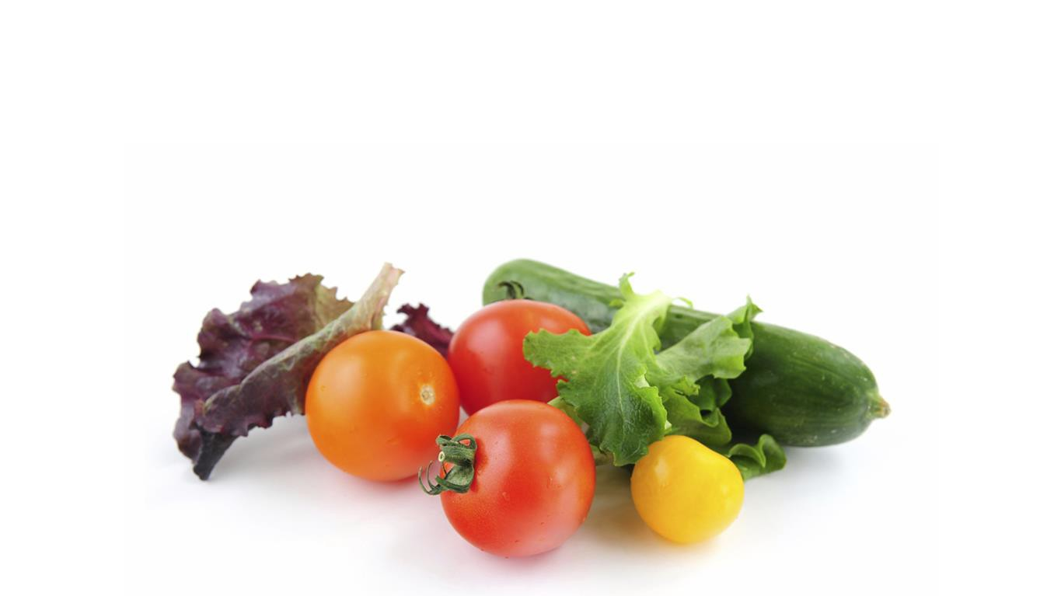
AB 1826
Organics Recycling Law
California Restaurant Association Meeting
September 19, 2018

Slide 2
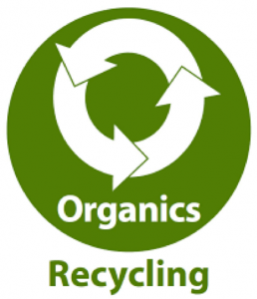
Who Must Comply
Per AB1826, Businesses that
• Generate 4 or more cubic yards of organic waste per week: Now.
• Generators of 4 or more cubic yards of solid waste per week: January 1, 2019.

Slide 3
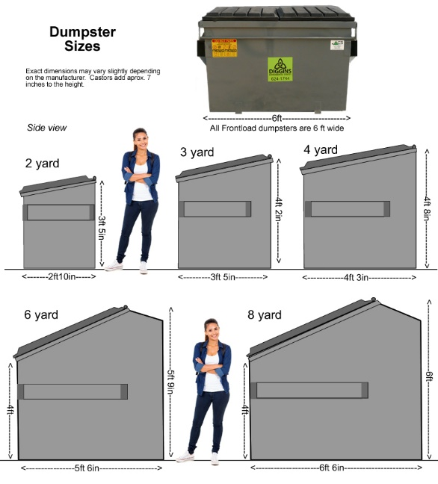
Common Dumpster Sizes

Slide 4
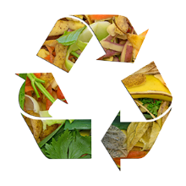
How To Comply
Businesses must recycling food waste by doing the following:
Separate organics & food waste from other waste.
Recycle organics on site.
Participate in an organics/food waste recycling service.
Most trash haulers have a food recycling service available.

Slide 5
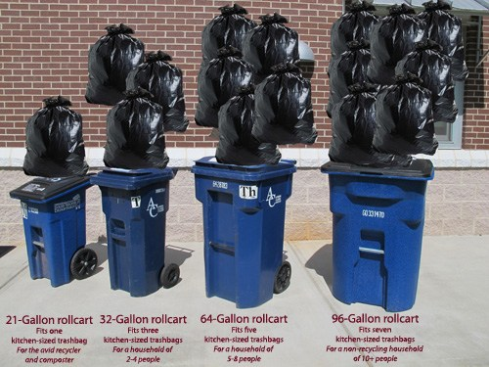
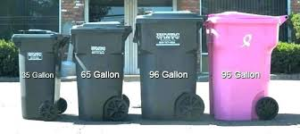
Exemptions
Per Sacramento Solid Waste Authority (SWA) Title IV, Section 4.01.150:
Generate less than 4 cu. Yds. of trash per week.
Generate less than ½ cu. Yd. of organic waste per week.
One 96 gal. toter equals ½ cu. yd.
Space issue.
Check with your hauler for available bin sizes – there are lots of different sizes.

Slide 6
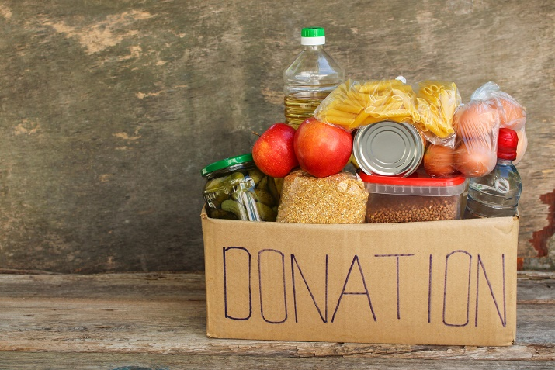
Reducing Organic Waste Generation
You can reduce the amount of organic waste you generate by:
Donating your unsold, fit for human consumption, food to a food donation facility, or program (AB 1219).
Composting on site.
Contact your local planning department for requirements.

Slide 7
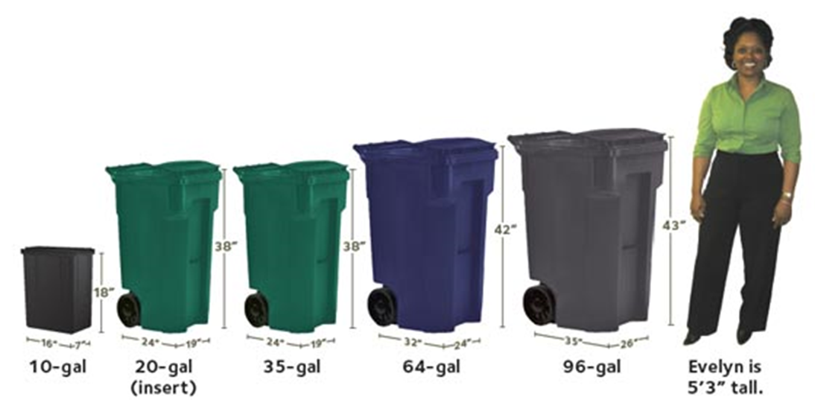
Contact your hauler for information on food SCRAp/waste bin costs.
Typical Food Waste Bin Sizes

Slide 8
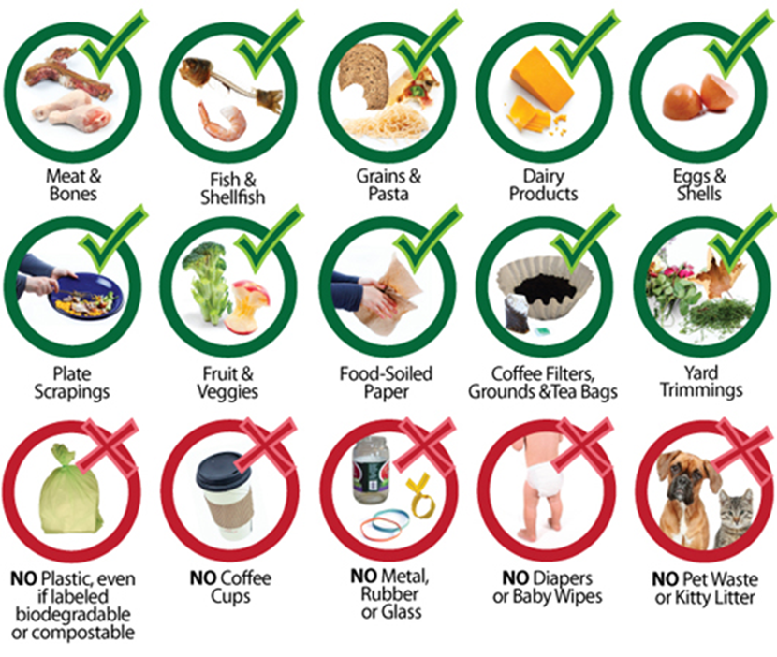
What Can Go Into Organic / Food Recycling Bin?

Slide 9
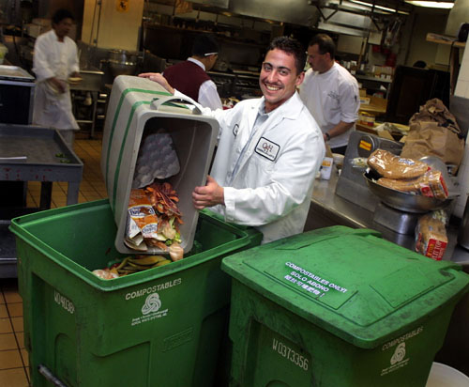
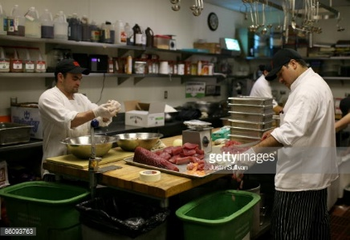
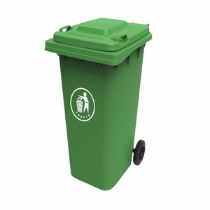
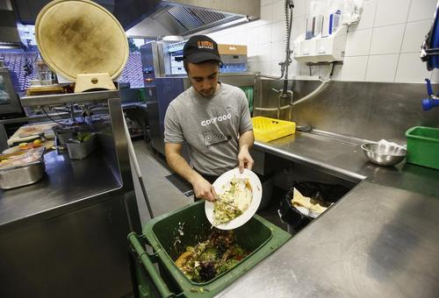
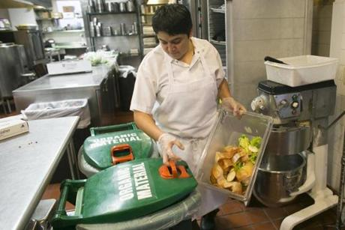
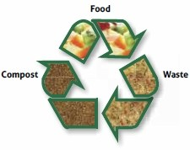
Food Recycling in Kitchens

Slide 10
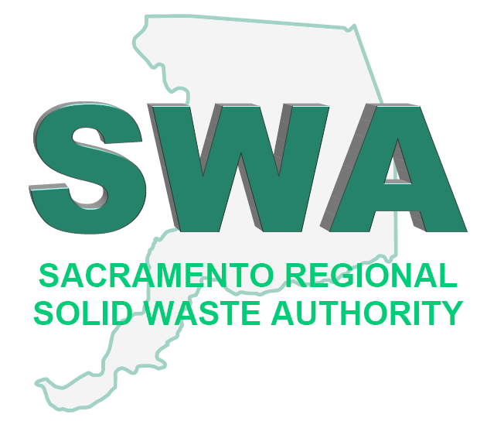
Questions?
CalRecycle Webpage:
www.calrecycle.ca.gov/Recycle/Commercial/Organics/
Sacramento County Solid Waste Authority Webpage:
www.swa.saccounty.net
Sharon Zimmerman (zimmermans@saccounty.net)
Terry Kociemba (kociembat@saccounty.net)
Eric Sutton (suttone@saccounty.net)
Or your Health Inspector

