Slide 1
Highlights of Changes to Waste Collection Requirements (2015 )

Slide 2
Current Regulatory Framework
SWA has limited ability to respond to complaints concerning cleanup of sites
Limited ability to require waste haulers or customers to keep collection sites clean, encouraging illegal dumping
Low commercial recycling rates (12%-24.5%)

Slide 3
Goals of Code Changes
Improve appearance of areas used for storing and collecting materials
Reduce incentives for illegal dumping
Increase participation of waste collection industry in meeting State recycling goals

Slide 4
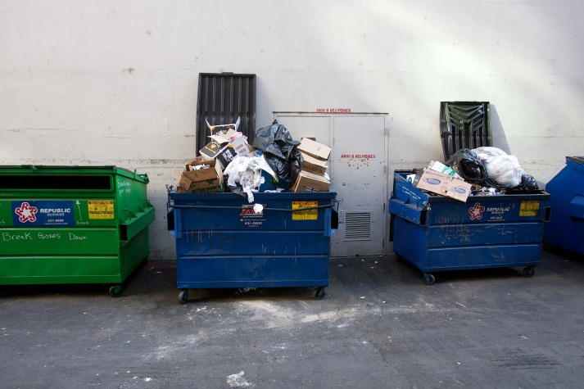
Goals
Lids are open. Recyclables and trash mixed together

Slide 5
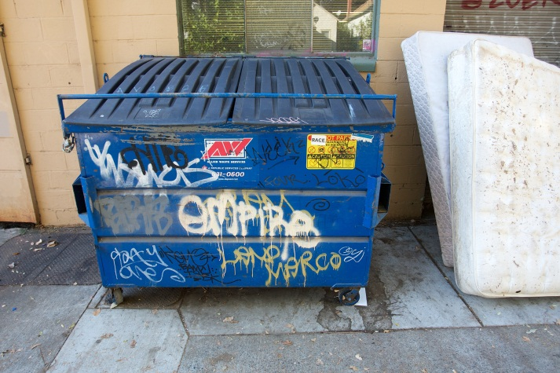
Goals
Bin covered with graffiti

Slide 6
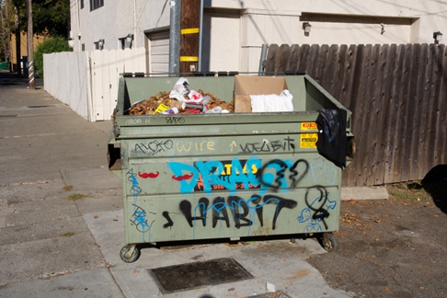
Goals

Slide 7
Goals
Bins overflowing and uncovered. Litter around bins.

Slide 8
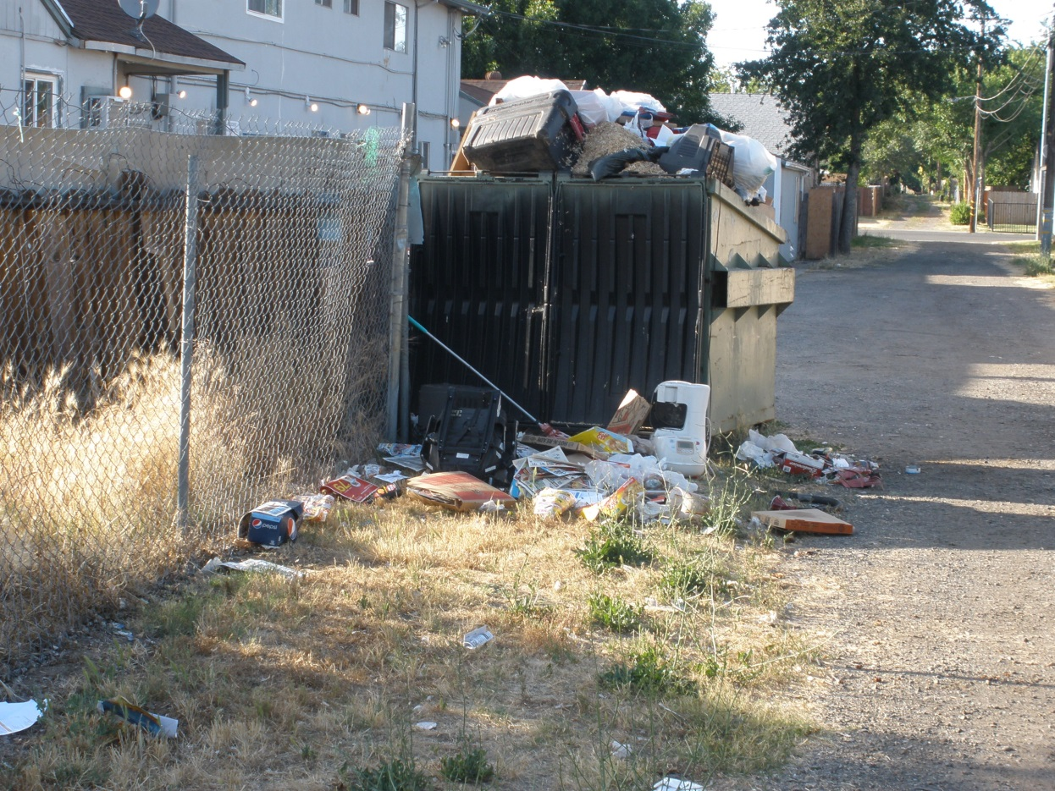
Goals
Bins overflowing and uncovered. Litter around bins.

Slide 9
Notes
Approx. 80% of collection sites are well-maintained
Enforcement of new requirements will only be taken on sites/issues that are reported to the SWA

Slide 10
Action steps
Dec-Jan:
Brainstorming on needed improvements
Unequal attempts at corrective action by industry
Jan-May: SWA Code changes
May-Aug: Revisions to Hauler Franchise Agreements for 2015

Slide 11
SWA Code 1.01: Diversion
Since 1996, haulers required to meet 30% diversion requirement by 1999. This was never met
Haulers required to meet 25% diversion requirement January 2015, increasing 1% every quarter until 30% is reached
Haulers to pay a $20/ton Recycling Incentive Fee if requirement not met

Slide 12
SWA Code 1.01: Containers
Business owner to have containers adequately sized and serviced with adequate frequency for waste and recycling
Containers must have tightly covered lids and contain odors (old)
SWA may require container labeling with customer identifying information in designated regions, and may require locking mechanisms
Bins must be labeled for recycling or waste, and free of graffiti

Slide 13
SWA Code 1.01: Containers
Violations may become the basis for enforcement actions
Haulers may also be subjected to liquidated damages, which are spelled out in their Franchise Agreement with the SWA

Slide 14
Hauler Franchise Agreement
Diversion Requirement:
Recycling Rate | Target Date
25% | January 1, 2015
26% | April 1, 2015
27% | July 1, 2015
28% | October 1, 2015
29% | January 1, 2016
30% | April 1, 2016

Slide 15
Hauler Franchise Agreement
Containers must have:
company identification
Type of material (waste/recyc)
Serviced with adequate frequency
Must prevent leakage
Must be equipped with lids & kept closed
Provide sufficient capacity for materials
Free of graffiti, cleaned and repainted as needed

Slide 16
Hauler Franchise Agreement
In Central Business District, bins must be:
Equipped with locking mechanism and kept locked when not being accessed
Identify customer and address to which container is assigned

Slide 17
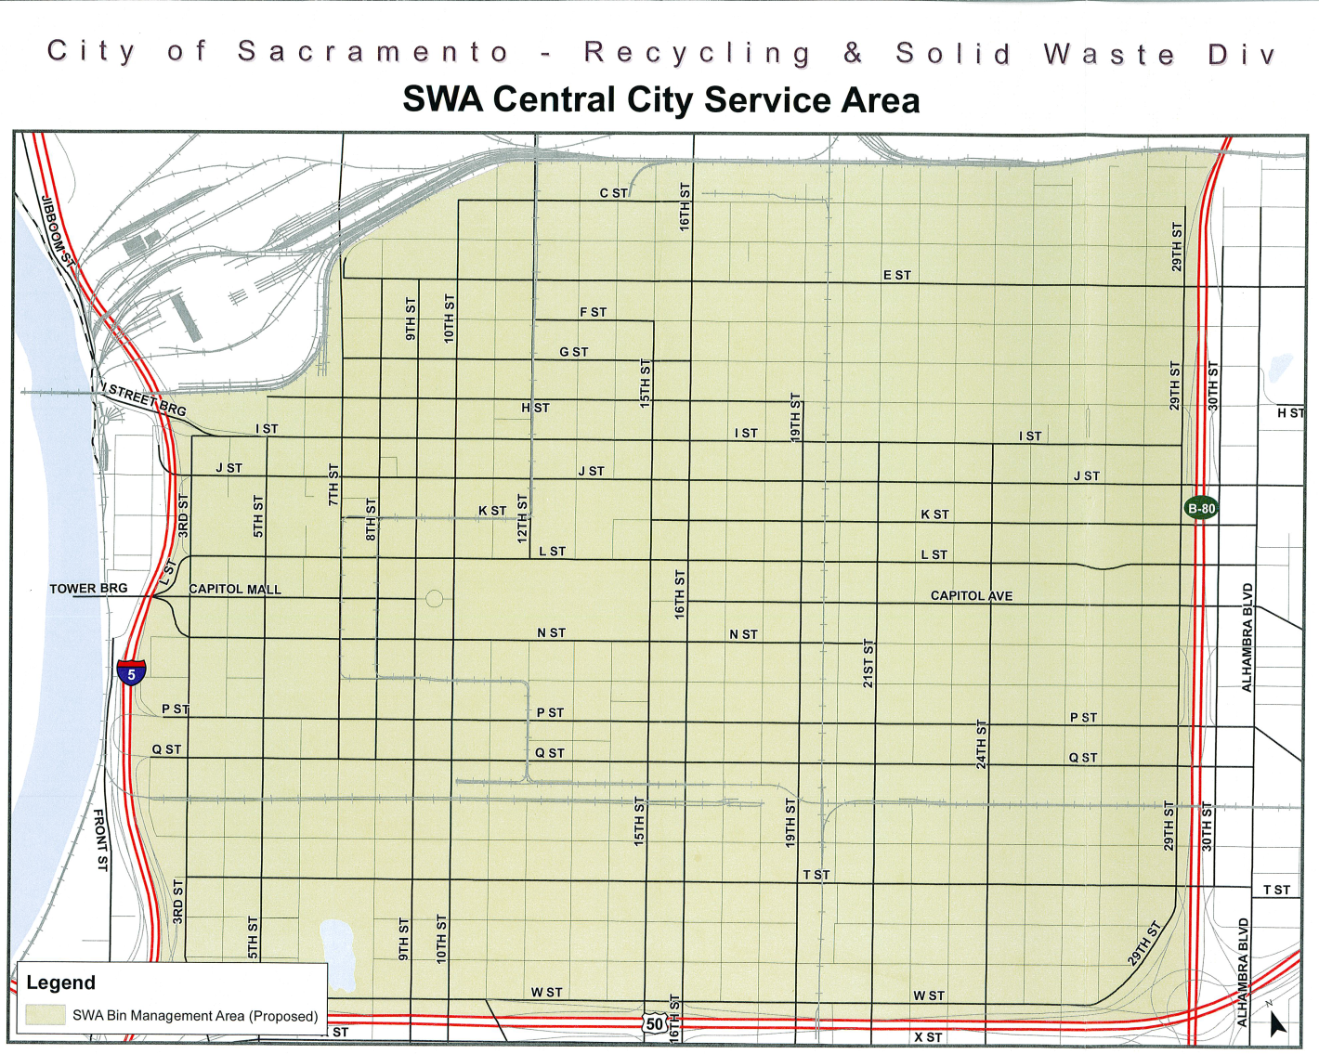
Hauler Franchise Agreement

Slide 18
Hauler Franchise Agreement
Deficiencies brought to the attention of SWA subjects Franchisee to liquidated damages:
Franchisee has 72 hours to correct deficiency.
If deficiency not correct, may subject Franchisee to enforcement action including termination of Franchise

Slide 19
Hauler Franchise Agreement
Draft Table of Liquidated Damages:
On-Site Storage and Container Standard | Liquidated Damage
Broken or missing lock bar, when required | $150
Broken or missing lock, when required | $150
Broken or missing lid | $150
Container graffiti | $150
Bin is not properly labeled | $150
Bin is overflowing, bin is leaking, material is spilling out of bin, or material is placed outside of bin on the ground | $250

Slide 20
Hauler Franchise Agreement
If Franchisee abandons container, SWA may remove and dispose of container, and may charge Franchisee for removal and disposal of container

Slide 21
Hauler Franchise Agreement
Assist in promoting waste diversion
Distribute outreach materials to their customers

Slide 22
Questions?
Etienne Ozorak
WM Program Manager
ozorake@SacCounty.net
916-875-4115

